Slide 1
All events are testable!

Slide 2
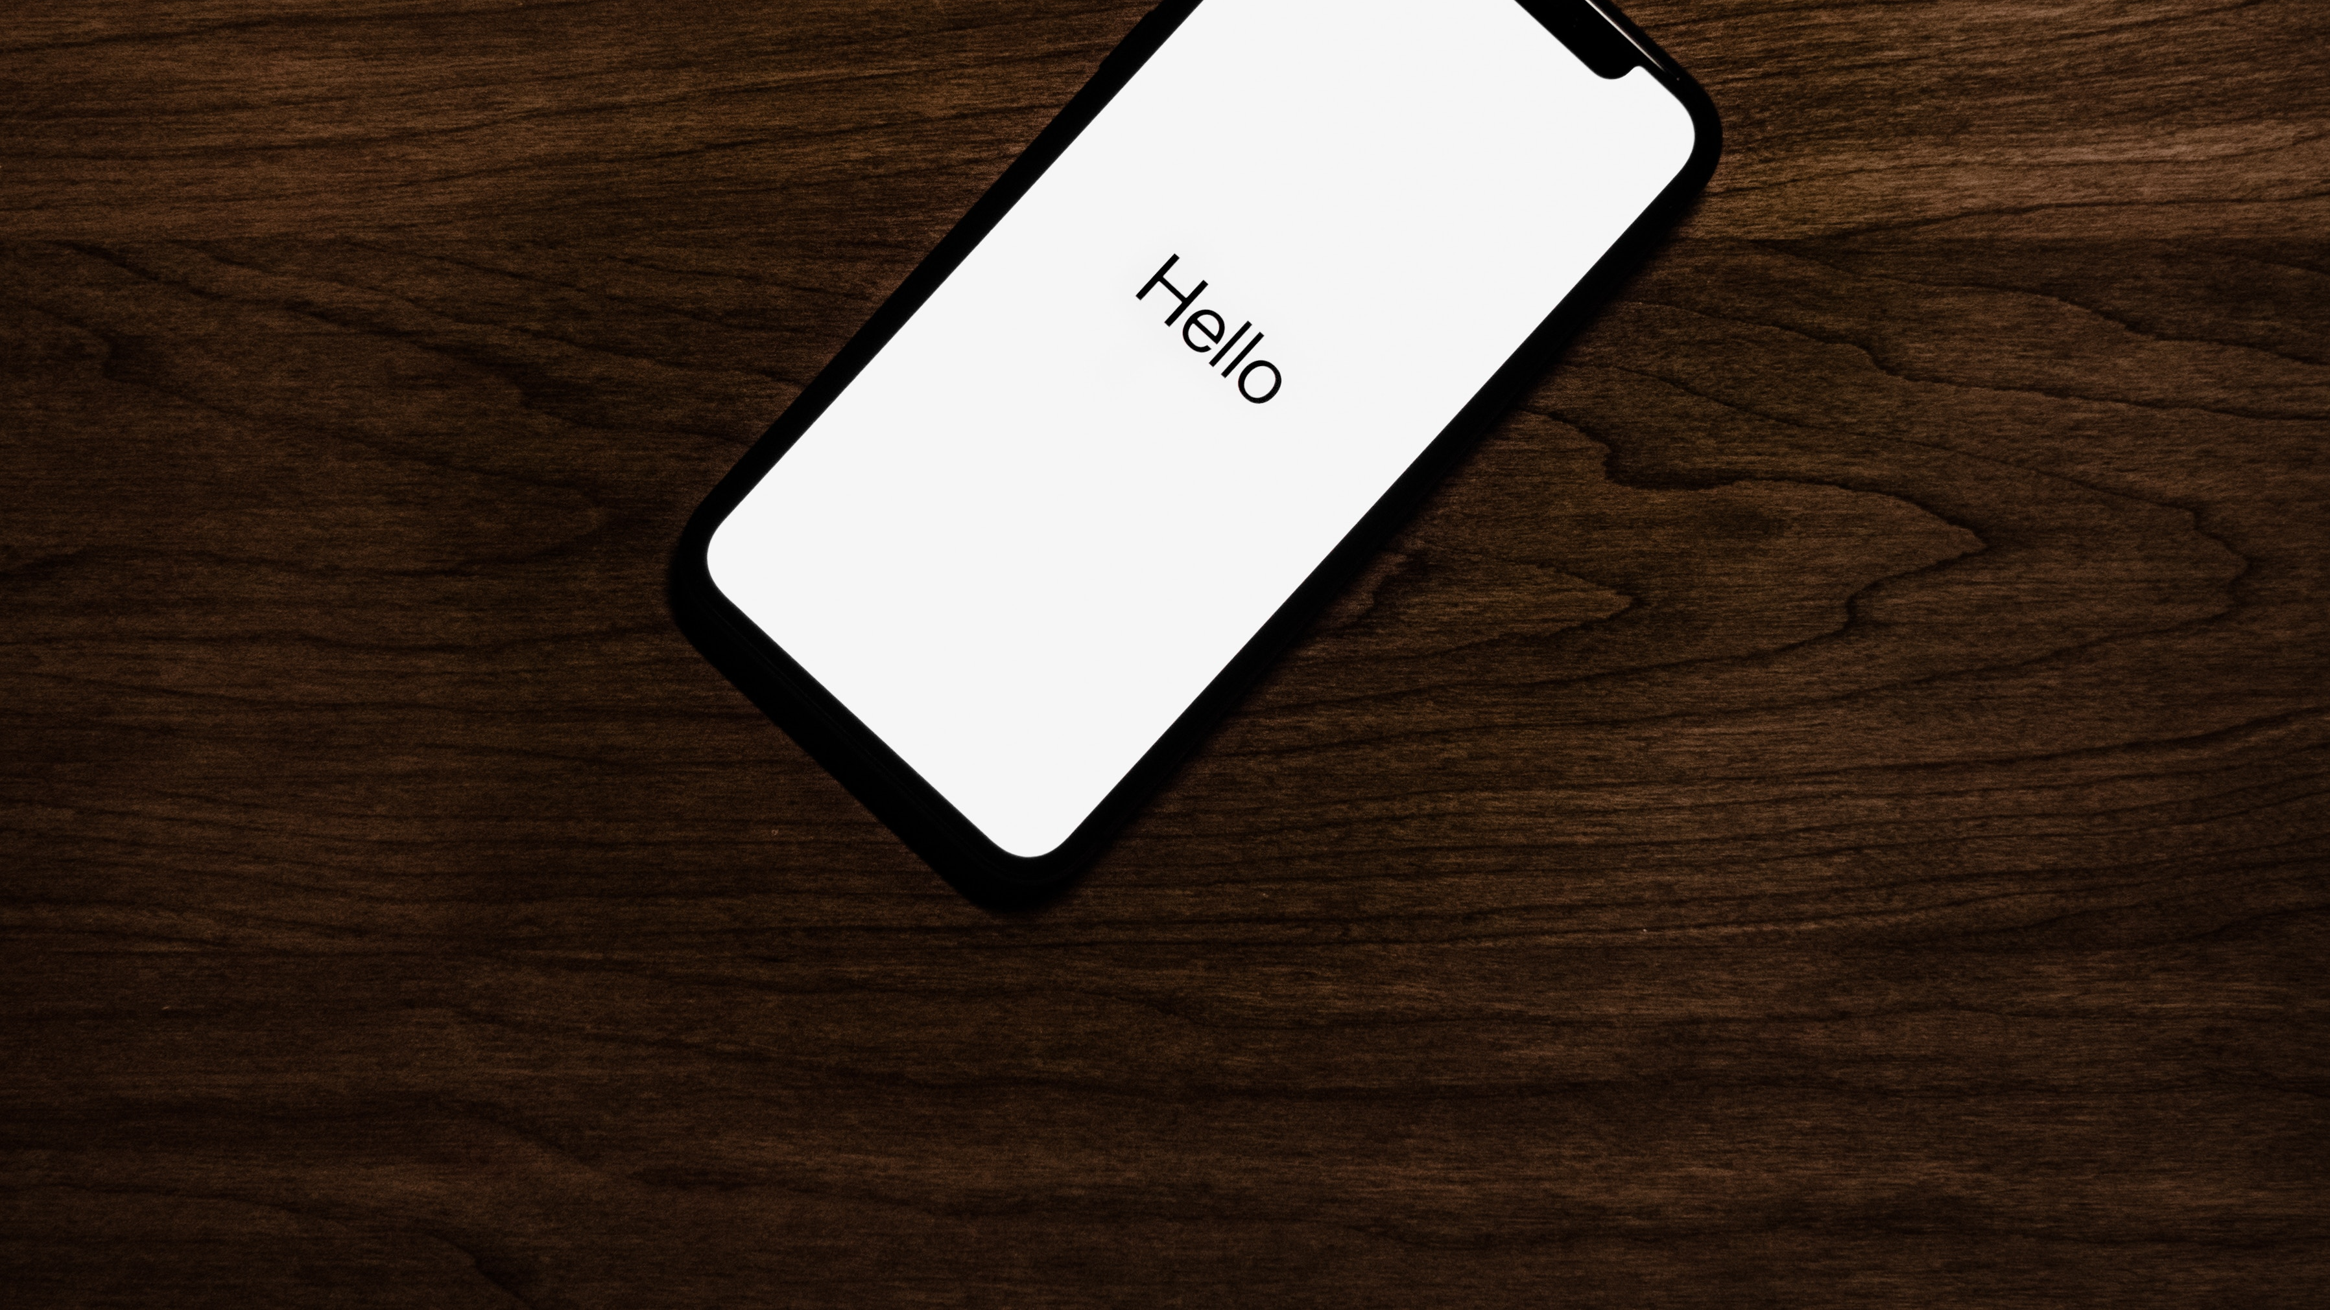
Introduction
Notes:
Timebox 30 minuti

Slide 3
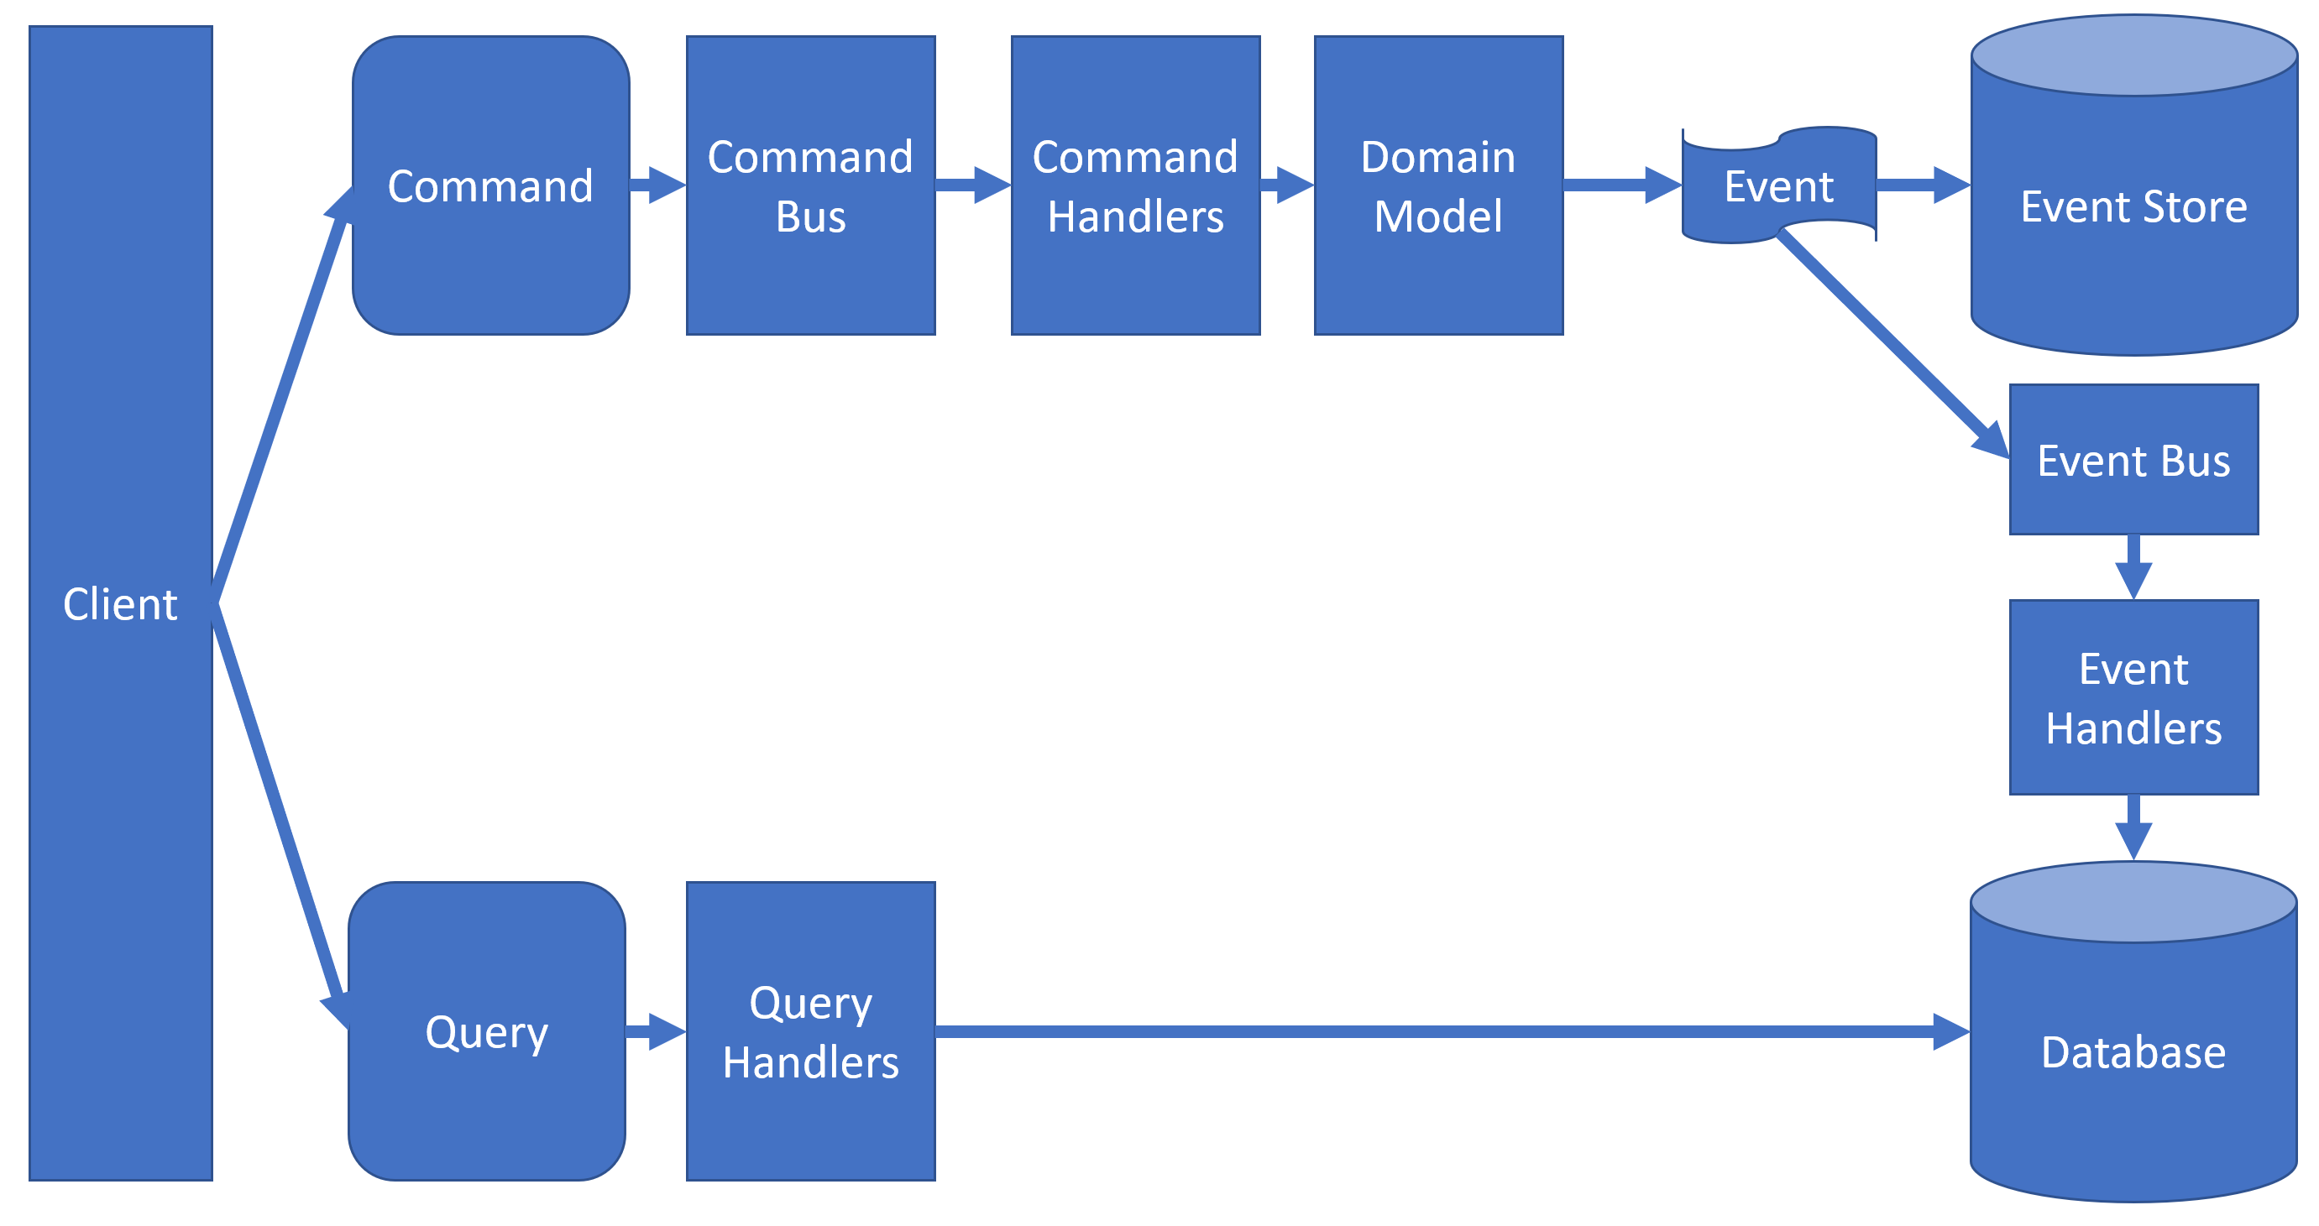
CQRS + ES fast recap
Notes:
l’idratazione degli aggregati qui non c’è, ignoriamo la persistenza

Slide 4
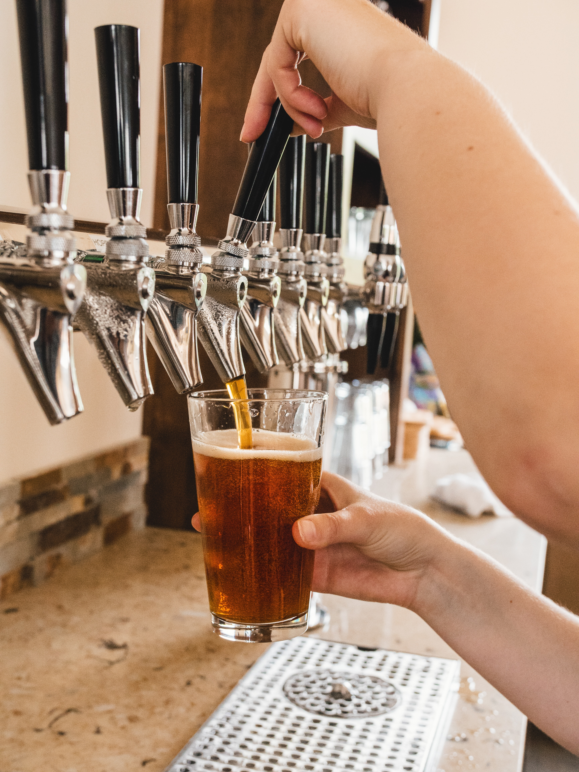
What is BrewUp
A demo ERP to handle a brewery’s processes
We purchase beers from neighboor breweries
We make our own line of beers
As you can imagine there is a lot to do (and drink!) in this domain

Slide 5
Scenario for today
We must handle a customer order made of beers that we do not make
We must check availabilities in our warehouse
In case, create an order to the external supplier
Handle the receiving of the ordered beers
Ship the order to the customer

Slide 6
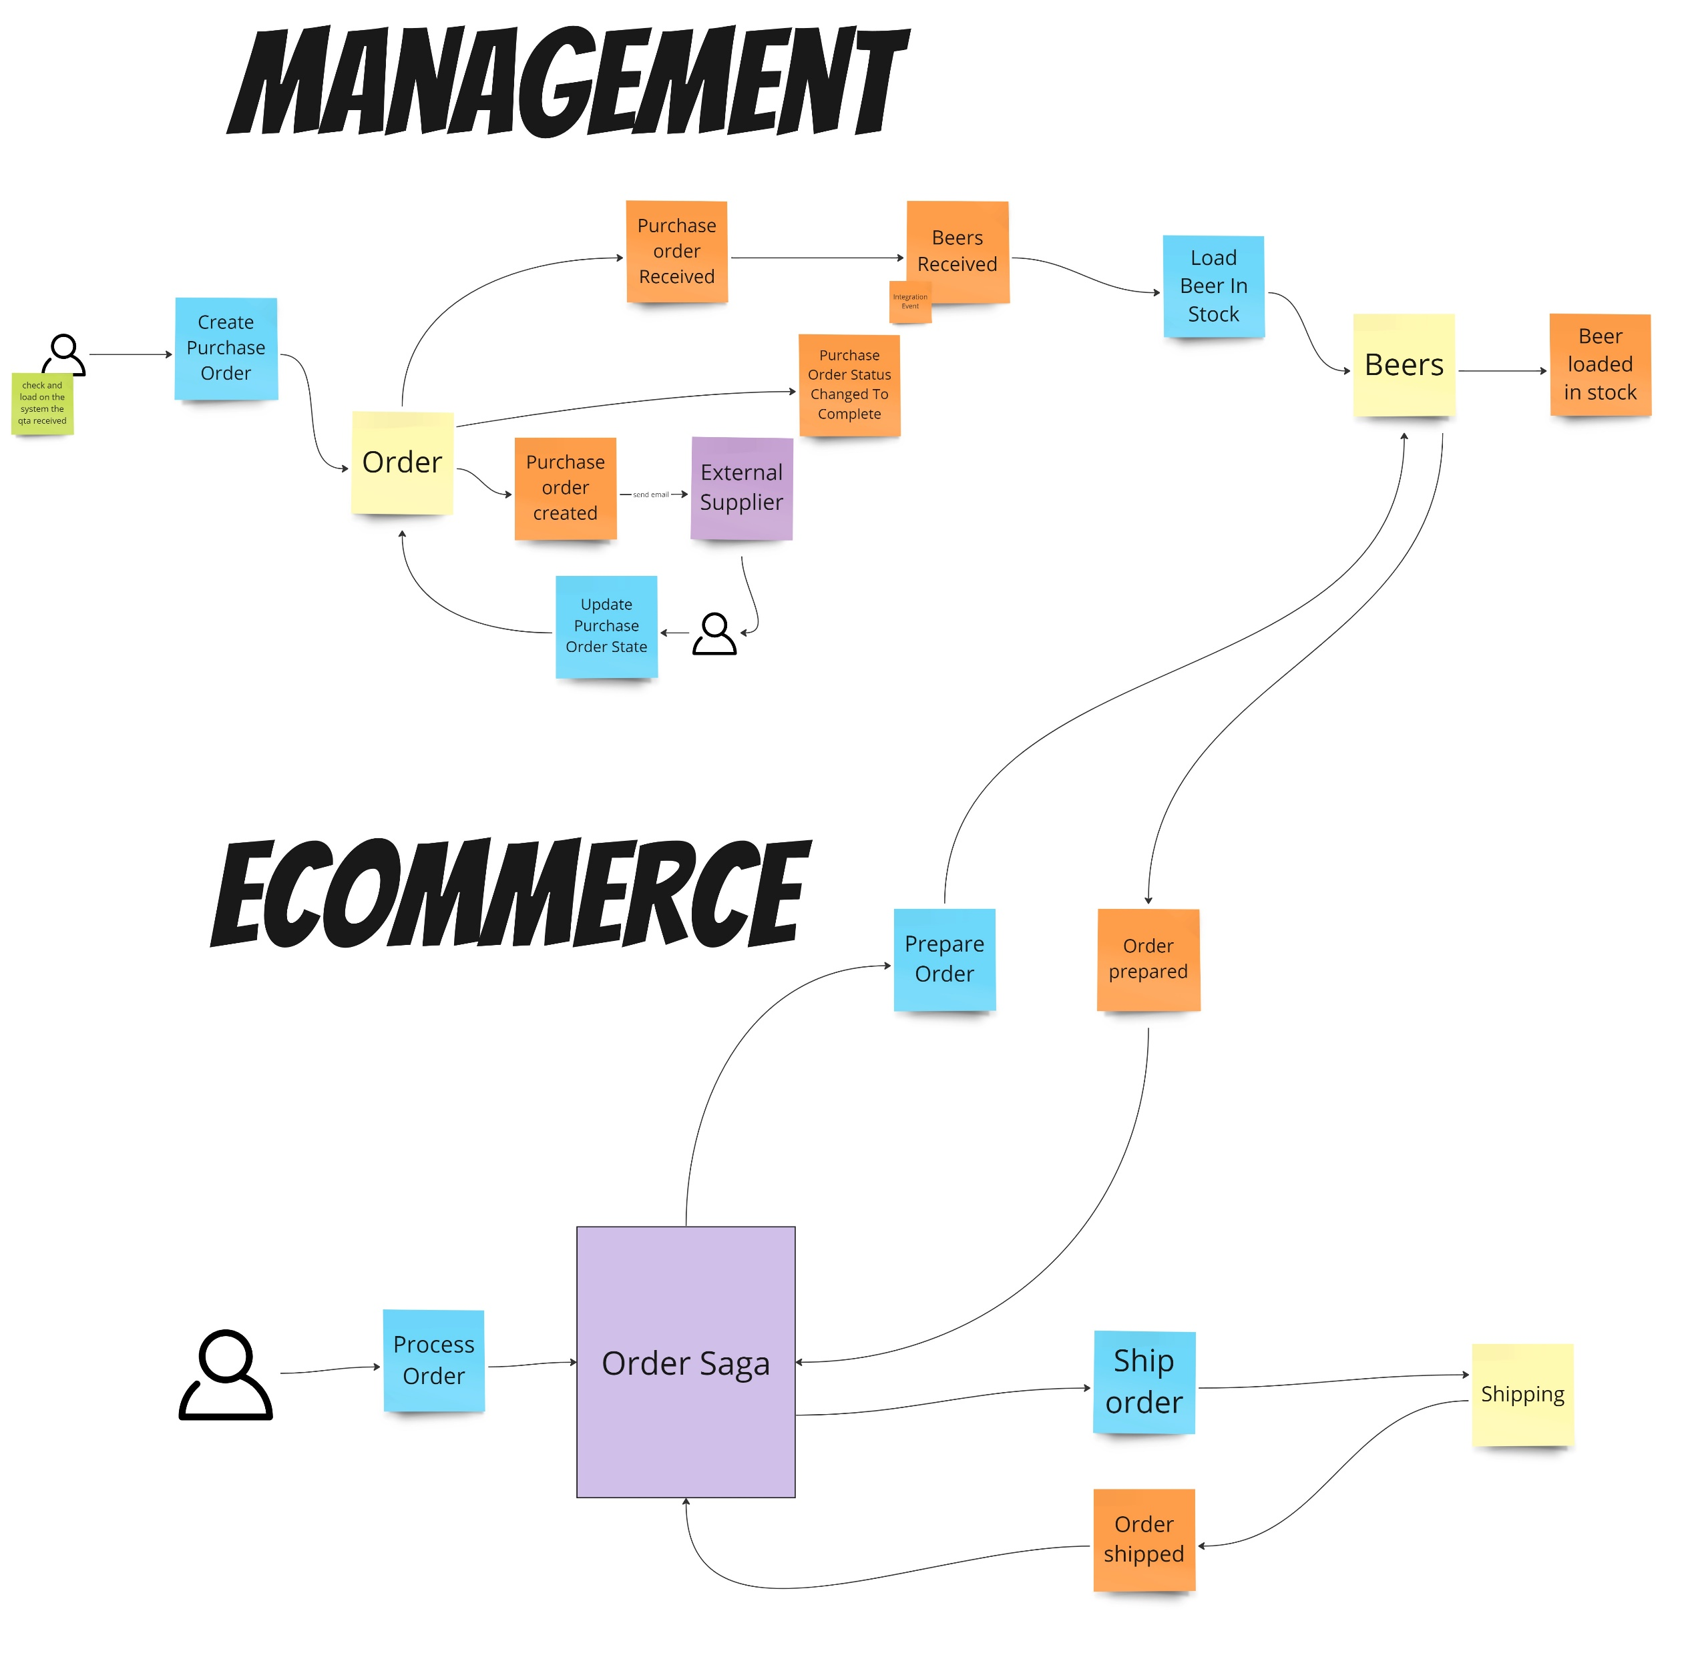
https://miro.com/app/board/uXjVMTJ642Y=/

Slide 7

How we test it?
Only with unit tests?
Would we not limit ourselves to the single function, properties or simple state testing?
Are these sufficient to represent the complexities of the domain?
Isn't it better to test the behaviour?
Notes:
Testare le proprietà di un messaggio, che per sua natura, in un’architettura simile, è immutabile non ha particolare significato

Slide 8
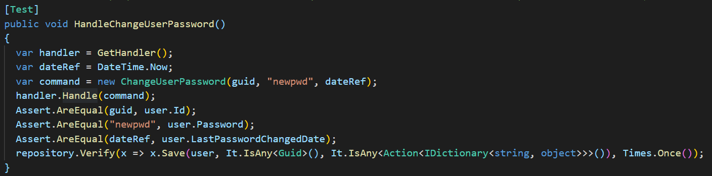
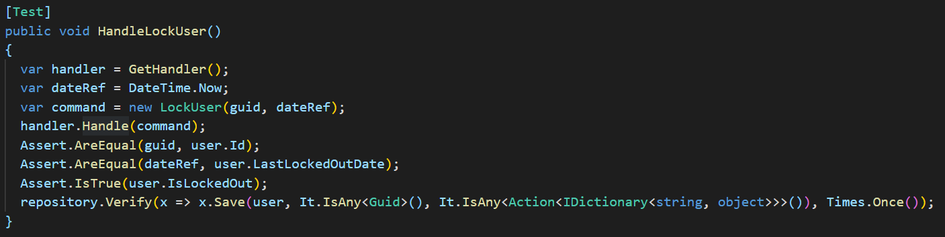
Once upon a time…there was an attempt…
https://github.com/Iridio/CQRS-ES_MembershipProvider

Slide 9

Let’s try with specification testing
Tests should be able to represent any complex behaviour with simplicity
They must be comprehensible to everyone
They represent the thinking behind the design of the aggregate
“Given, When, Then” with events, commands and command handlers

Slide 10
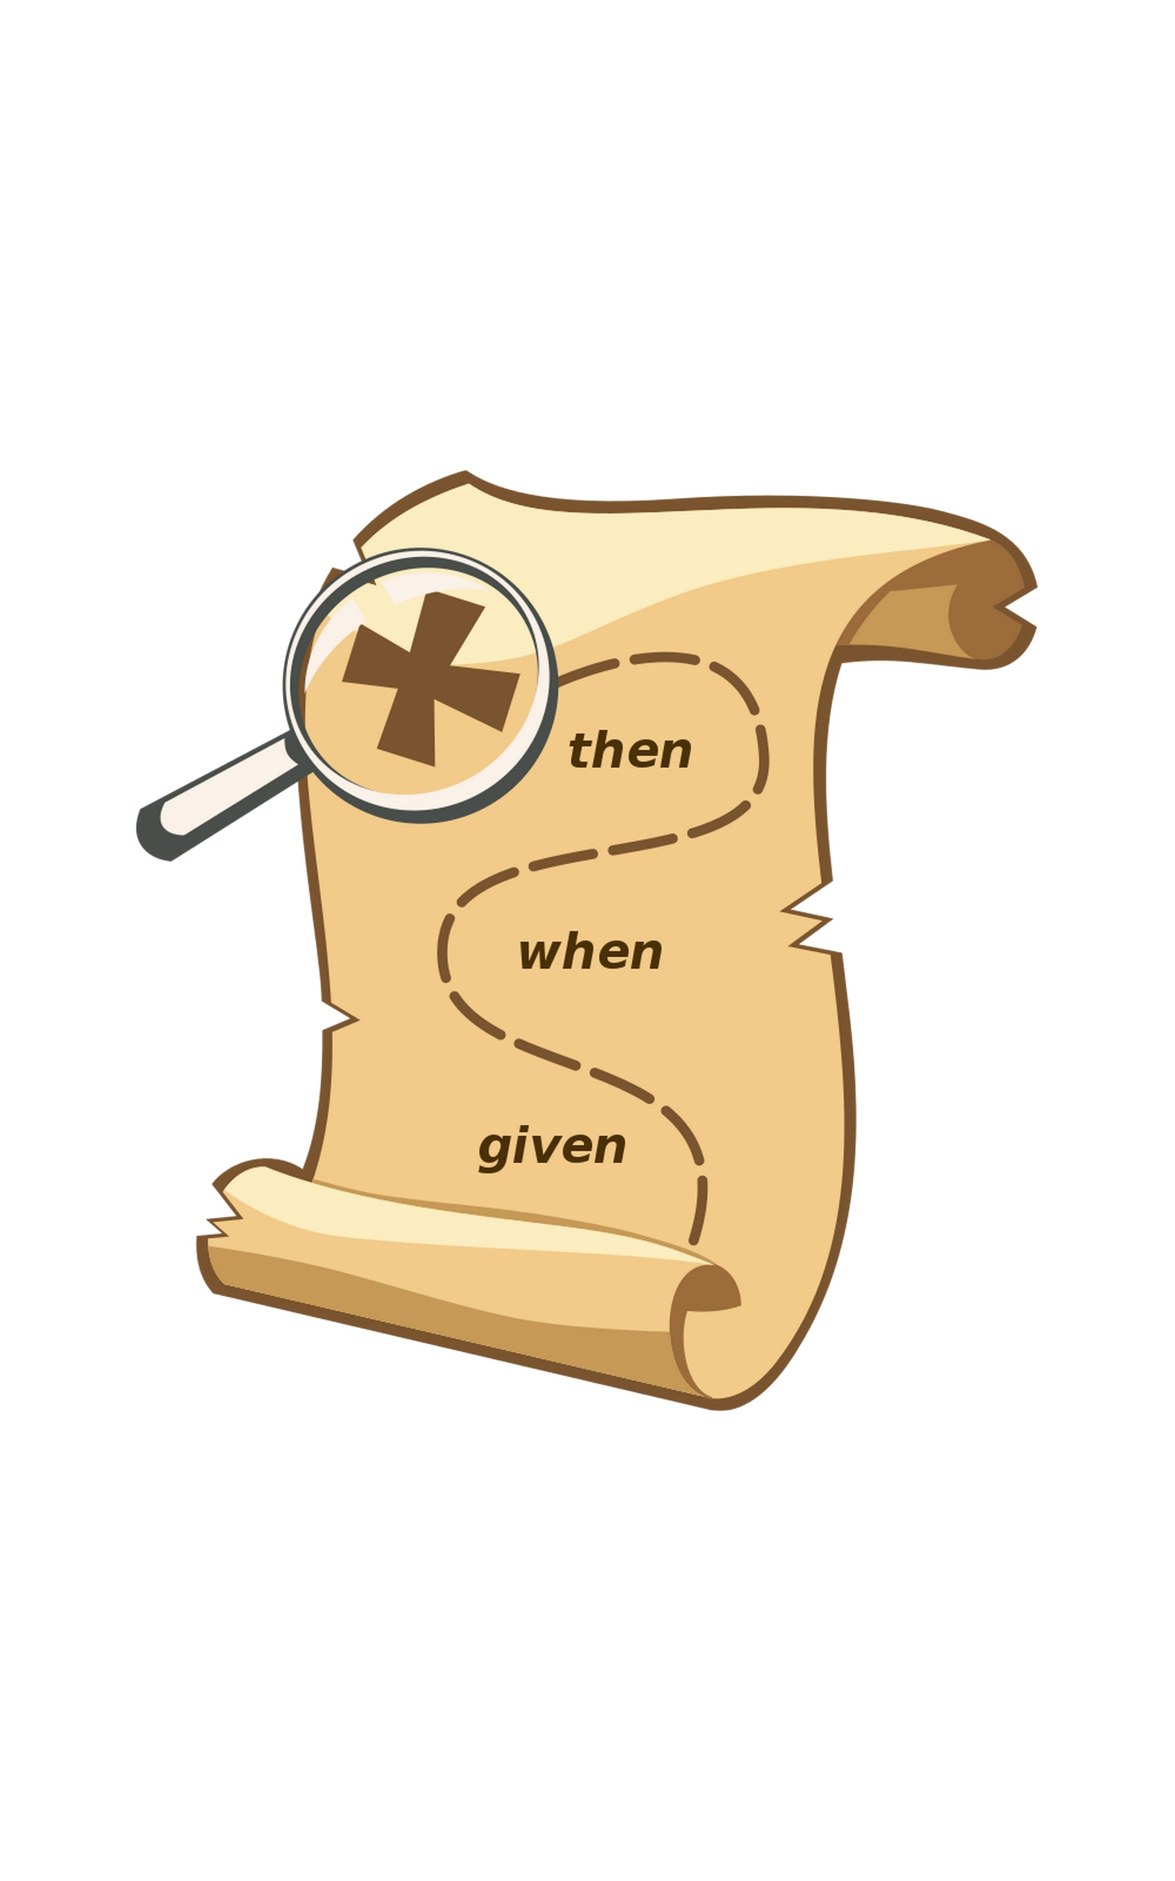
Given, When, Then
The idea is to separate a scenario into three sections:
Given: describes the state of the aggregate before sending the command. A kind of prerequisite for the test.
When: represents the command to be sent to the aggregate.
Then/Expect: describes the state changes expected as a result of the command.

Slide 11
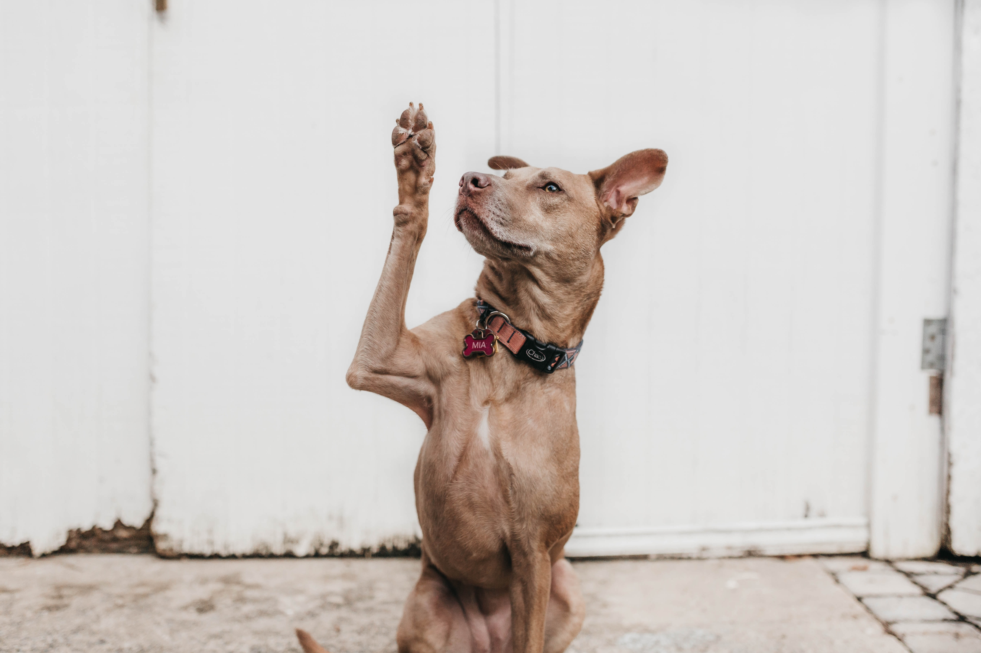
Questions?
Notes:
Timebox 5 minuti

Slide 12

Have a look to the code together

Slide 13

Test Scenario
Write tests and events to handle:
CreatePurchaseOrder -> PurchaseOrderCreated
UpdatePurchaseOrderState -> PurchaseOrderReceived
PurchaseOrderReceived -> BeersReceived
LoadBeerInStock -> BeerLoadedInStock

Slide 14
https://miro.com/app/board/uXjVMTJ642Y=/

Slide 15
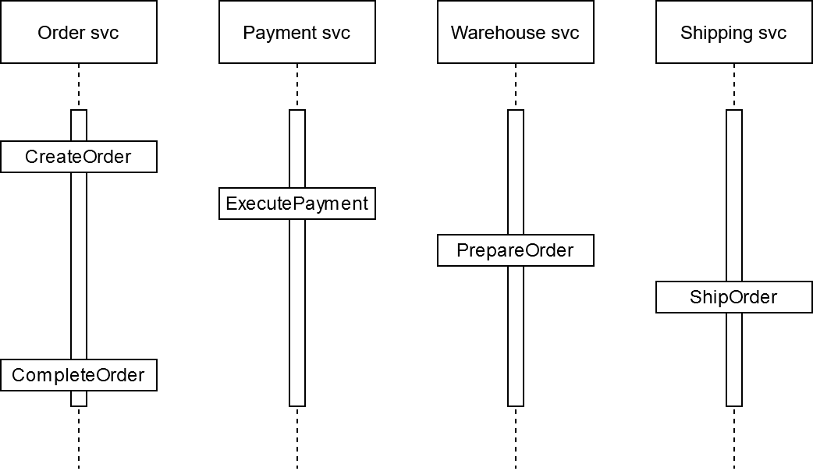
Scenario
Notes:
Non si può fare una transazione unica, specie con servizi/bounded context differenti

Slide 16
Choreography (Events) Orchestration (Command)

Slide 17
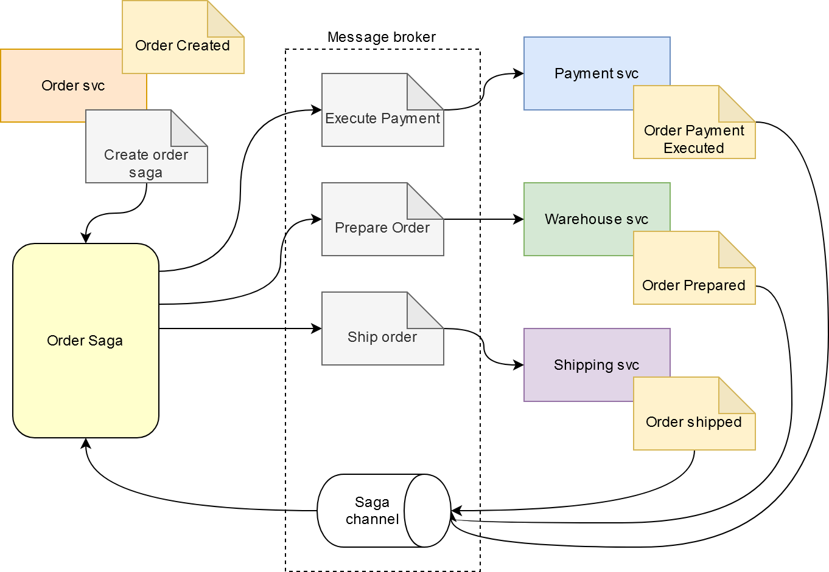

Slide 18
What if there is no product in stock?

Slide 19
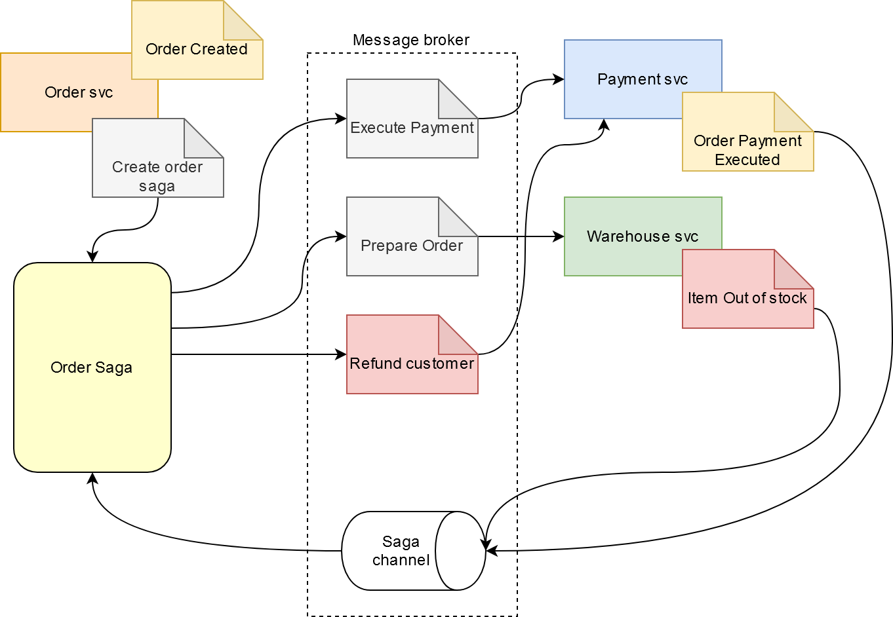

Slide 20

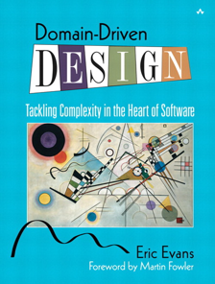
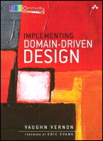
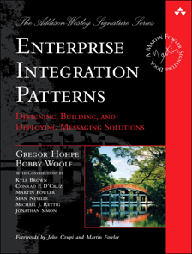
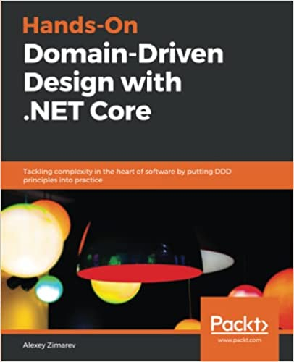
Bibliografy
Domain-Driven Design: Tackling Complexity in the Heart of Software (E. Evans) https://www.amazon.it/Domain-Driven-Design-Tackling-Complexity-Software-ebook/dp/B00794TAUG
Implementing Domain-Driven Design (V. Vernon) https://www.amazon.it/Implementing-Domain-Driven-Design-Vaughn-Vernon-ebook/dp/B00BCLEBN8/
REST in Practice: Hypermedia and Systems Architecture (J.Webber) https://www.amazon.it/REST-Practice-Hypermedia-Systems-Architecture/dp/0596805829
Enterprise Integration Patterns (G. Hohpe) https://www.amazon.it/Enterprise-Integration-Patterns-Designing-Deploying/dp/0321200683/
Hands-On Domain-Driven Design with .NET Core (A. Zimarev) https://www.amazon.it/Hands-Domain-Driven-Design-NET/dp/1788834097

Slide 21
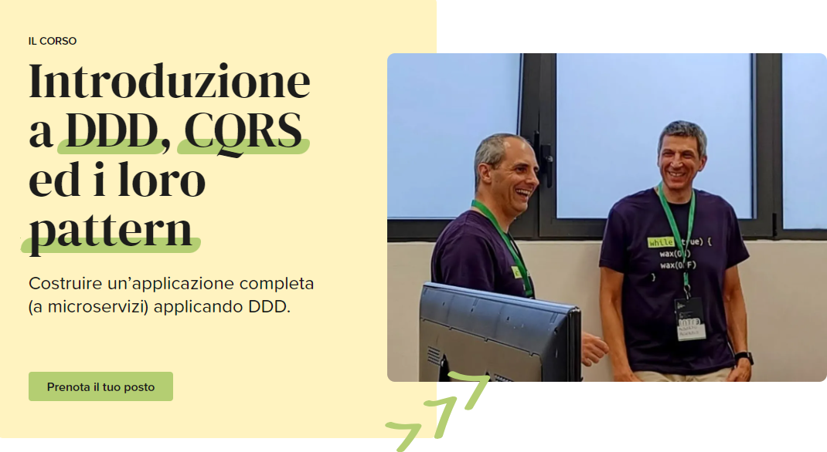

Slide 22






THANKS!
You can find us at:
@aacerbis
aacerbis
alberto.acerbis@intre.it
@collaalessandro
alessandrocolla
alessandro.colla@evoluzione.agency
Clone the code:
BrewUp

